Slide 1
QuaNTIFYING ELEMENTS OF A LUNAR ECONOMY BASED ON RESOURCE NEEDS
Jeffery B. Greenblatt, PhD
Founder, CEO and Chief scientist, Emerging Futures, LLC
annual meeting of the Lunar Exploration Analysis Group, Columbia, MD
11 OCTOber 2017

Slide 2
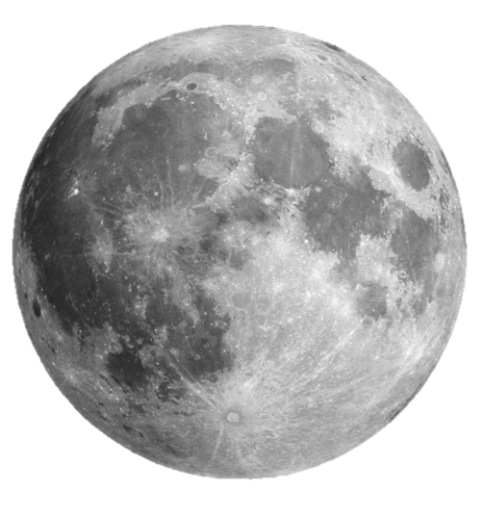
The basis of a lunar economy
Maximum self-sufficiency enabled by in situ Lunar resource utilization
Trade with Earth and other Solar System locations
Basic commodities produced locally or procured elsewhere:
Human life support (water, air, food)
Structural materials (metals, concrete, glass, plastics)
Industrial chemicals (H₂SO₄, etc.), fertilizer (N, K, P) and propellant
Solar photovoltaics
Bonus: rare earth elements, precious metals, uranium, ³He

Slide 3
What is abundant? What is rare?
Based on lunar analysis in: Crawford (2015)
Colaprete et al. (2010)
PERMANENT (2002)
Plenty of Si, Ca, Mg, Al, Fe, Ti, O
Materials made from these elements are abundant enough to export
Smaller quantities of Na, K, P, S, F, Cl
Sufficient provided only small quantities are needed, and materials used are efficiently recycled
Scarce supplies of H, C, N, everything else
Water found at poles, but supplies likely limited (a few ~Gt)
Trace quantities of solar wind-impregnated H₂, CH₄, NH₃, etc. in surface regolith
Can collect and recycle small quantities of volatiles, but if need large amounts, may need to import

Slide 4
How much do we need?
For a detailed report on this analysis, see:
emerging-futures.com/moon-vs-mars.html
An overview infographic can be found at:
spaceeconomy.spacevault.world/moonvsmars
Structural materials and industrial chemicals:
Assume 2x consumption rate of China on a per capita basis (rapidly growing Lunar economy), scaled down to reflect lower Lunar gravity. Some substitutions allowed among materials (concrete, steel, Al, Mg, wood).
Human sustenance:
Food and fertilizer: Assume global averages (1.3 kg/person/day food; N 3.3%, P 1.3%, K 0.9% of food mass)
Water: California per capita consumption for all uses, scaled down to reflect greater efficiency (1,100 kg/person/day). Assume much smaller quantities of water exported for Space use (30 kg/person/day).
Air (20% O₂ in N₂/Ar): Based on NASA estimates (5 kg/person/day)
Propellant and solar PV: Sufficient to support surface needs and export
We assume aggressive recycling (e.g., 99.5% for water, 97% food/air) to minimize total required raw materials

Slide 5
Energy and Resource constraints
Energy (assume solar PV with H₂/O₂-based energy storage):
Building use based on Antarctic and ISS energy consumption (13 kW/person, about 10x U.S. average)
Industrial use: assume 2x Chinese energy intensity (26 MJ/kg)
Solar PV, water and propellant: 150 MJ/kg, 3 MJ/kg, 29 MJ/kg (H₂/O₂) or 5 MJ/kg (regolith—more on this below)
Limit development to 0.1% of Lunar farside (nearside off-limits to preserve cultural heritage of Moon)
This allows ~19,000 km² for mining and coverage by solar PV—about the size of Slovenia
Solar output is high (no atmosphere): about 1.3 TW available on average (~11% of current power on Earth)
Limit water consumption to ~0.01%/yr (8,000 year lifetime): slow enough to avoid rapid resource loss
Insufficient water for export or large-scale propellant production; must use regolith ablation for propulsion
Limit organic materials (food, structural plants, plastic, other hydrocarbons) to surface use; no exports!

Slide 6
results
50,000 people can be supported indefinitely on Lunar surface—no more!
Abundant power and inorganic materials can allow export of 300 M t/yr (enough for 170 M people)
Mars/asteroids could supply additional inorganic materials plus volatiles to support a total of 250 M people in Space
Abundant O₂ could be exported as propellant component (or air), perhaps in exchange for imports of H, C, N, electronics, etc.
Gross Interplanetary Product™ (“GIP”):
A very crude estimate of the Lunar GIP is based on power consumption scaled to GWP/power on Earth
Earth = $76 trillion / 12.4 TW (in 2015) = $6.1/W
Moon = 1.3 TW x $6.1/W = $8 trillion
Likely very low, as Lunar activities per capita expected to be much higher than on Earth (compare to ULA’s Cis-Lunar 1000 estimate of $2.7 trillion for 1,000 people)
Additional GIP comes from a major Lunar export: solar PV for use in Space
Another 3.9 TW or $24 trillion added to economy each year

Slide 7
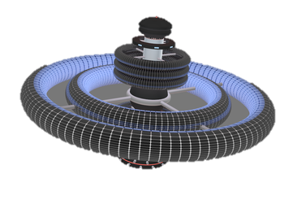
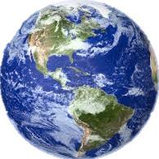
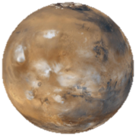
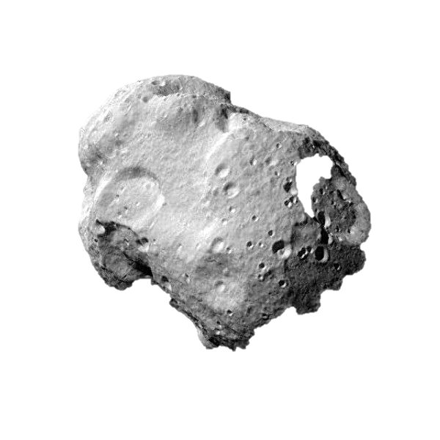
Lunar trading partners
Space settlements
(not aliens!)
Moon’s low gravity is a competitive advantage for providing solar PV, equipment and supplies in Space
Inorganic materials, O₂, solar PV, equipment, people
People, Space-manufactured equipment?
People, supplies, equipment
People, ³He?, uranium?
People, rare earth elements, metals?, ³He?
Volatiles, people
Jeff Bezos: In long term, Earth must shift all heavy industry off-planet; Moon might be a good location!
Precious metals, volatiles, people
Inorganic materials, O₂, solar PV, equipment, people
Moon and Mars can complement each other in supplying materials to asteroids/Space settlements

Slide 8
Thank you!
Unlocking the Solar System’s Gross Interplanetary Product™
EmergingFutures.space
SpaceXchange.world
jeff@emerging-futures.com
+1 (510) 693-6452
@EmergingFutLLC

